Slide 1

TASK ASSIGNMENT

Slide 2
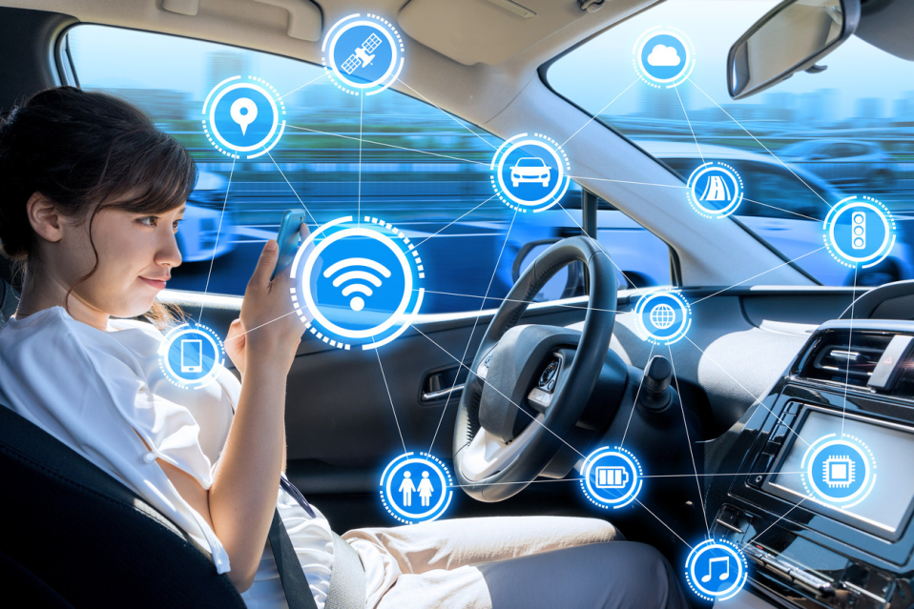
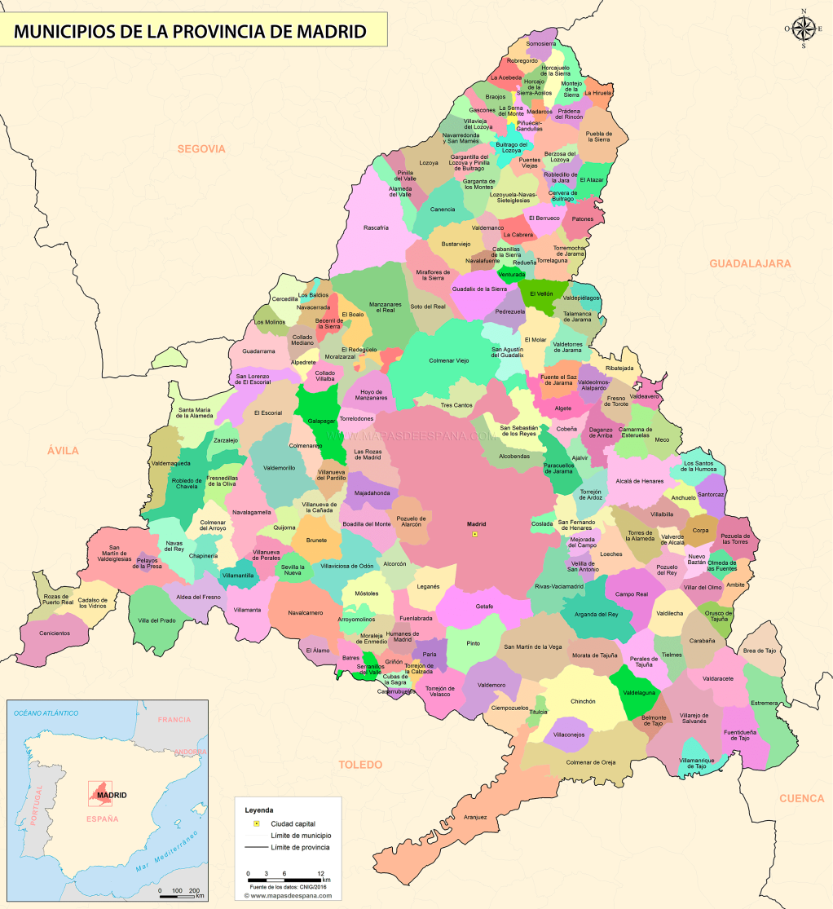
Analysis of electromobility impact in the region of Madrid

Slide 3
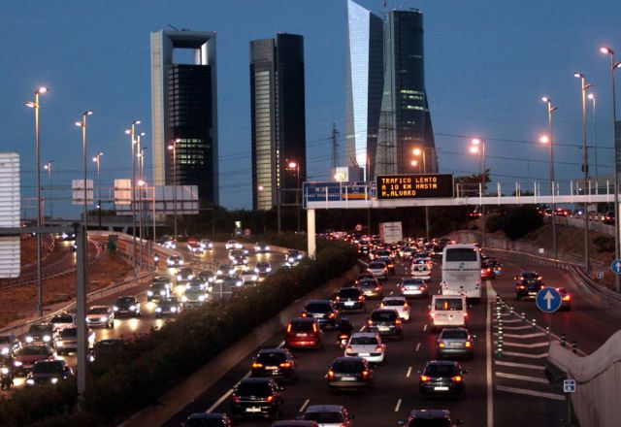
EV&BD session use case
Annually, Madrid government provides a register of vehicle movements
All journeys made between the towns of the Comunidad de Madrid are gathered together to create the “Madrid’s mobility atlas”.
Further info is available at http://www.madrid.org/iestadis/fijas/estructu/general/territorio/atlasmovilidad2017/INDEX.html

Slide 4
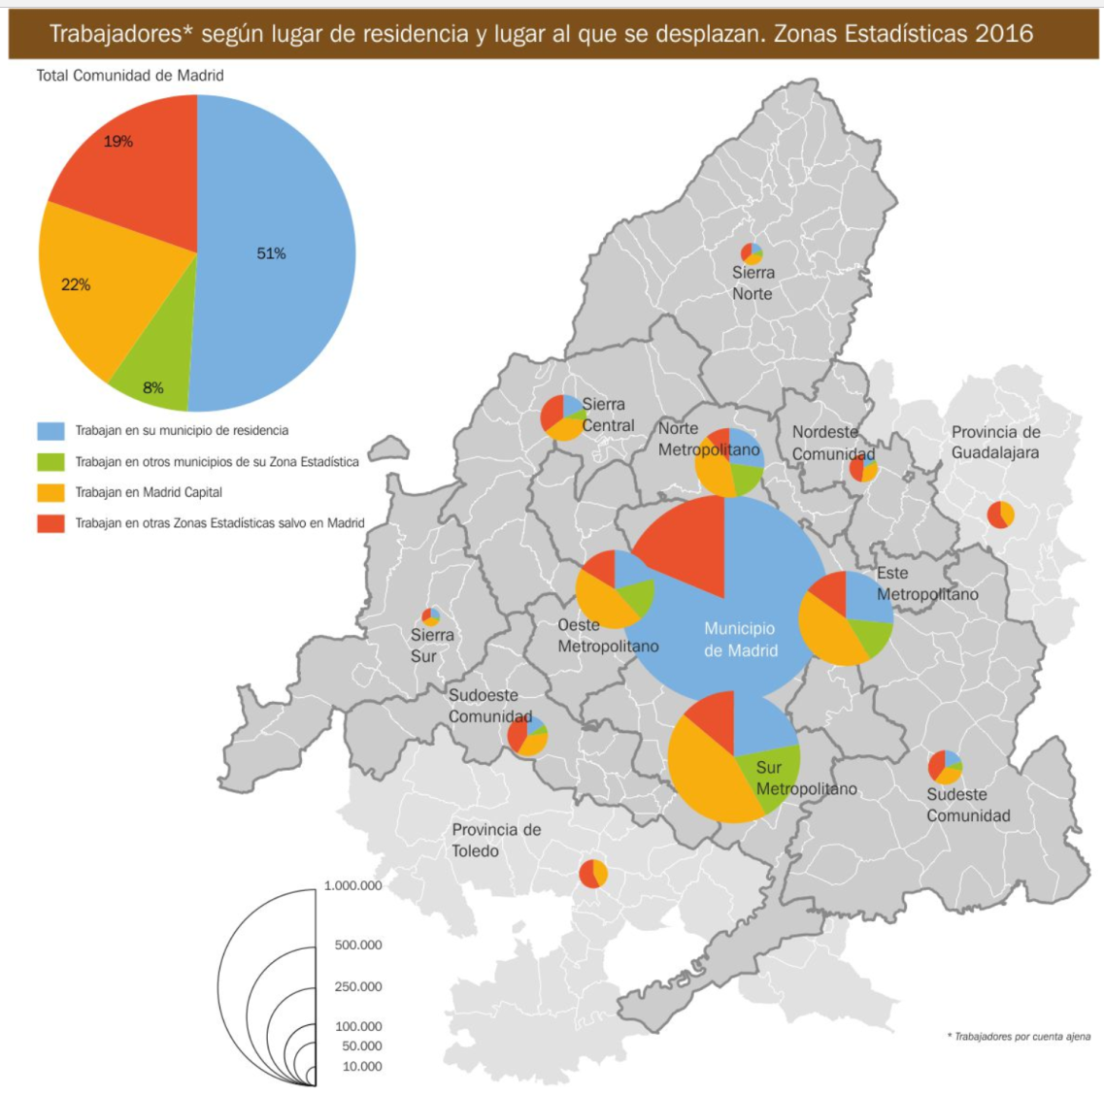
EV&BD session use case
The figure shows the statistics regarding the journeys driven by workers depending the living zone.
Blue – Working at their living area
Green – Working close to the living area
Orange – Working at Madrid

Slide 5
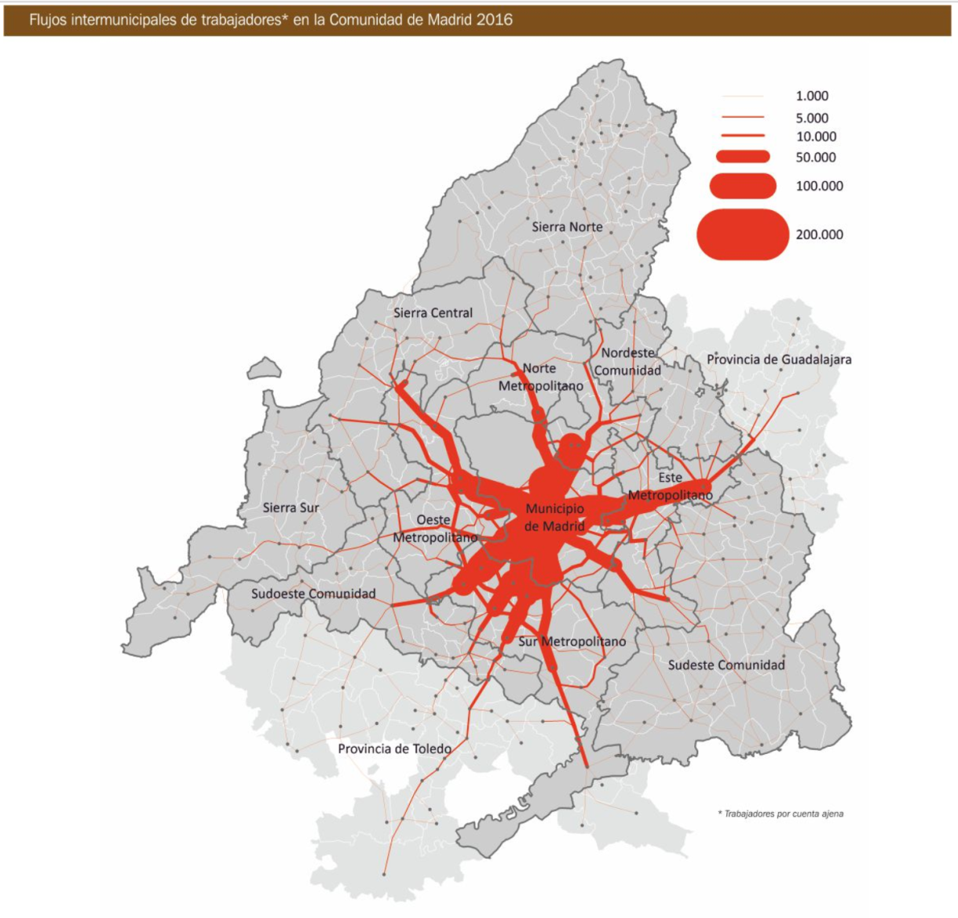
EV&BD session use case
Aggregated journey flows.
Now, Let’s go electric!

Slide 6

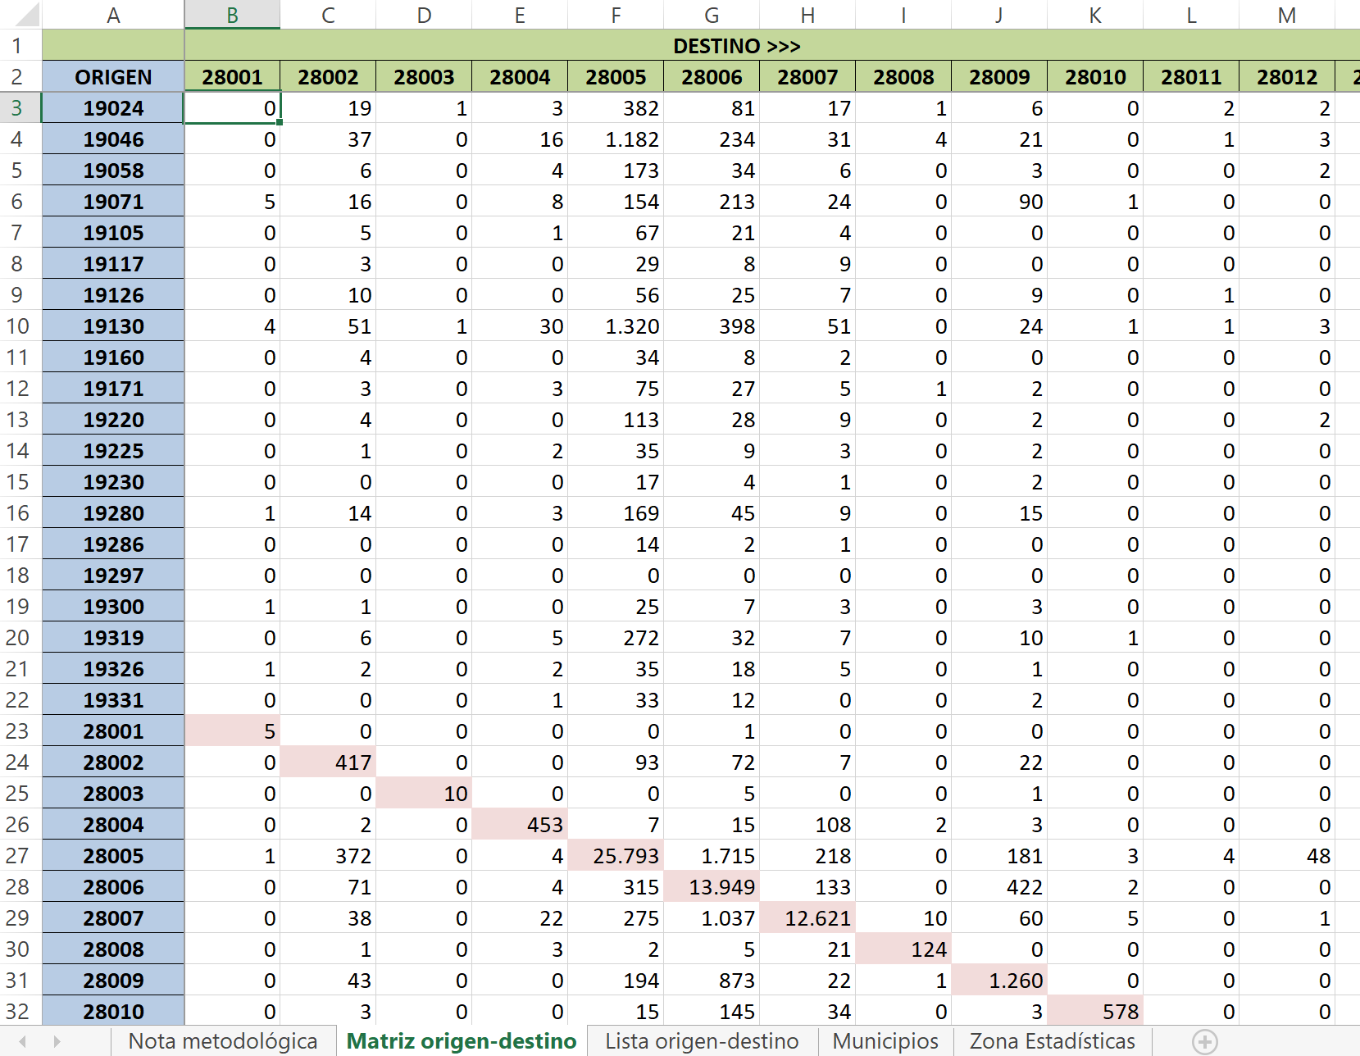
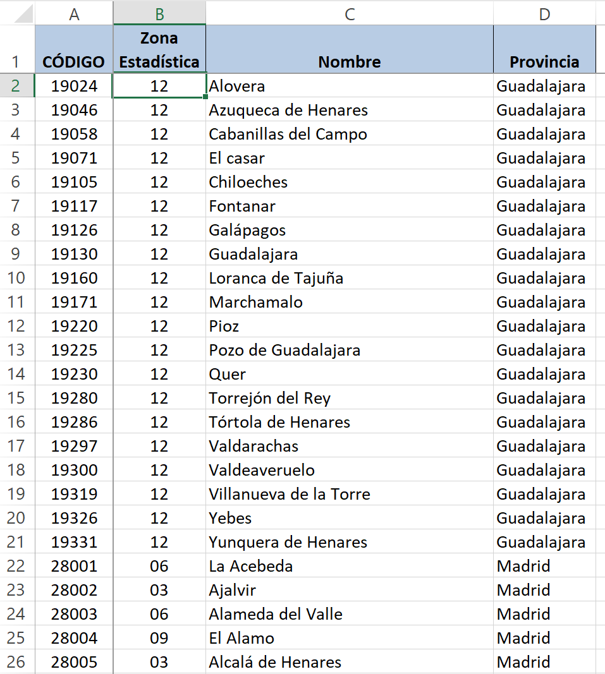
EV&BD session use case
DATA PROVIDED. Work Mobility in Madrid
http://www.madrid.org/iestadis/fijas/estructu/general/territorio/atlasmovilidad2017/INDEX.html

Slide 7
EV&BD session use case
How to get journeys’ time and distance from the Google API using Excel:
Insert the next function in the (VB) editor of Excel:
Function Journey(Origen, Destino) Declaration of variables Dim URL As String Dim Row(1 To 1, 1 To 2) As Double Dim xml, html, Val As Variant ‘Special characters need to be converted (through Caracter_e function) for Origen and Destino Origen = Caracter_e(LCase(Origen)) Destino = Caracter_e(LCase(Destino))

Slide 8
EV&BD session use case
‘url should be composed to allow the data request as a matrix URL = "https://maps.googleapis.com/maps/api/distancematrix/xml?origins=" & Origen & "&destinations=" & Destino _ & "&mode=" ' (default option is car)
‘Assign propoerties to Html and Xml values to invoque Set html = CreateObject("HTMLFile") Set xml = CreateObject("Microsoft.XMLHttp") ‘Ask for the data with the info from URL and synchronous request xml.Open "POST", URL, False xml.Send

Slide 9
EV&BD session use case
‘To capture the response html.body.innerHTML = xml.responseText
‘Acquisition of time and distance Set Val = html.getElementsByTagName("value") Row(1, 1) = CLng(Val(0).NextSibling.Data) / 86400 'tiempo (horas) Row(1, 2) = CLng(Val(1).NextSibling.Data) / 1000 'distancia (km)
‘Function is ready Ruta = Row ‘Free variables Set xml = Nothing Set html = Nothing Erase Row Val = Empty End Function

Slide 10
EV&BD session use case
Private Function Caracter_e(ByVal especial) As String Dim Matriz, i, max As Double ‘Matrix size With Sheets(1) Final = Application.CountA(.Range("J:J")) Matriz = .Range(.Cells(2, 9), .Cells(Final, 10)) End With max = UBound(Matriz)
‘Create a loop to search special cells while executing “Ruta” For i = 1 To max especial = Replace(especial, Matriz(i, 1), Matriz(i, 2)) Next Caracter_e = especial End Function

Slide 11
EV&BD session use case
How to get the data from the Excel
To fulfill the cells with the function it is mandatory to use matrices:
First we must place the function in the first cell of the matrix, so in “C2” we write =ruta(A2;B2), next we select C2 and D2 cells and press F2, we choose the function and then press CTRL + SHIFT + ENTER, this way we insert the matrix,
: {=ruta(A2;B2)}, in both cells.

Slide 12
EV&BD session use case
Other issues
The format of columns should be changed.
DURACIÓN es h:mm (hours).
DISTANCIA #.##0,00 (Km).
ZONA ESTADISTICA DE TRABAJO | TRABAJADORES | RESIDENCIA | TRABAJO | Caracteres | Validacion | DURACION | DISTANCIA
03 | 19 | Alovera | Ajalvir | á | a | 0:27 | 33,3
06 | 1 | Alovera | Alameda del Valle | é | e | 1:13 | 110,71
09 | 3 | Alovera | El Alamo | í | i | 1:03 | 99,8
03 | 382 | Alovera | Alcalá de Henares | ó | o | 0:24 | 20,10
02 | 81 | Alovera | Alcobendas | ú | u | 0:35 | 45,23
04 | 17 | Alovera | Alcorcón | ñ | n | 0:48 | 67,58
09 | 1 | Alovera | Aldea del Fresno | Ç | c | 1:13 | 104,62
02 | 6 | Alovera | Algete |  |  | 0:30 | 41,48
08 | 2 | Alovera | Ambite |  |  | 0:43 | 47,27

Slide 13
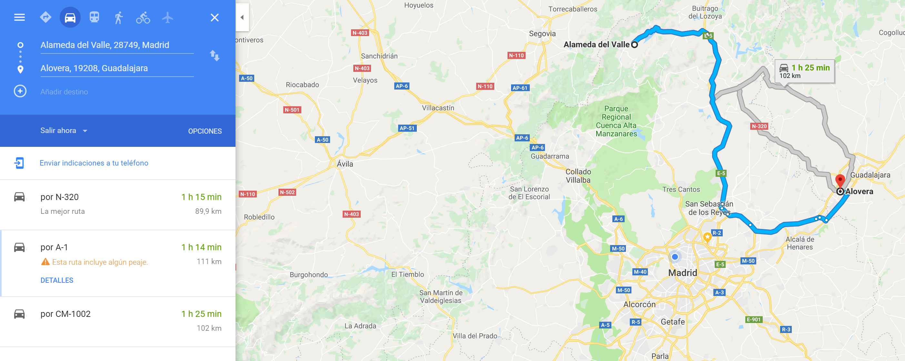
EV&BD session use case
ZONA ESTADISTICA DE TRABAJO | TRABAJADORES | RESIDENCIA | TRABAJO | Caracteres | Validacion | DURACION | DISTANCIA
03 | 19 | Alovera | Ajalvir | á | a | 0:27 | 33,3
06 | 1 | Alovera | Alameda del Valle | é | e | 1:13 | 110,71
09 | 3 | Alovera | El Alamo | í | i | 1:03 | 99,8
03 | 382 | Alovera | Alcalá de Henares | ó | o | 0:24 | 20,10
02 | 81 | Alovera | Alcobendas | ú | u | 0:35 | 45,23
04 | 17 | Alovera | Alcorcón | ñ | n | 0:48 | 67,58
09 | 1 | Alovera | Aldea del Fresno | Ç | c | 1:13 | 104,62
02 | 6 | Alovera | Algete |  |  | 0:30 | 41,48
08 | 2 | Alovera | Ambite |  |  | 0:43 | 47,27

Slide 14
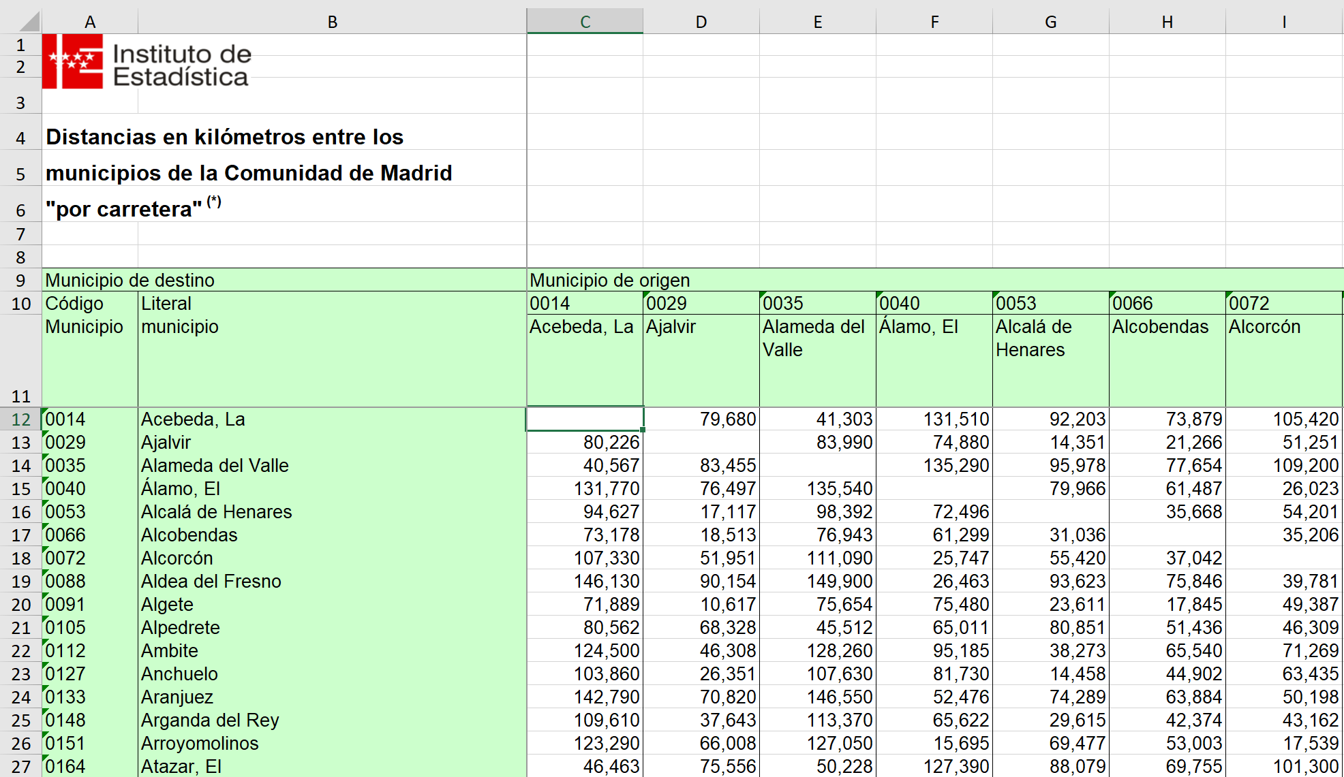
EV&BD session use case
DATA PROVIDED. Distances between cities in Madrid
http://www.madrid.org/iestadis/fijas/estructu/general/territorio/estructu_dismun.htm

Slide 15

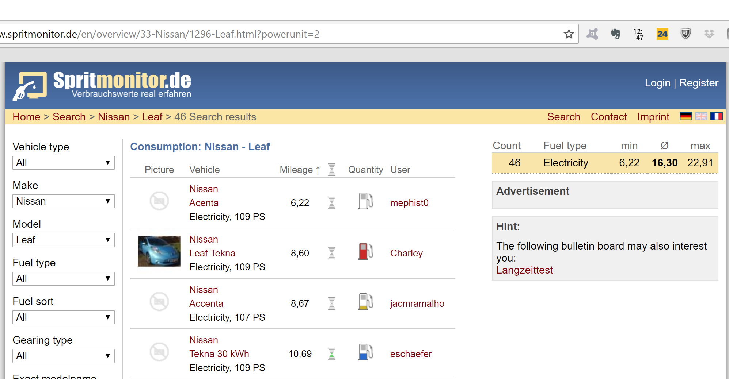
EV&BD session use case
Calculate the power consumption (electric energy from the EV batteries) associated to the journeys.
https://www.spritmonitor.de/en/
https://www.adac.de/infotestrat/tests/eco-test/

Slide 16
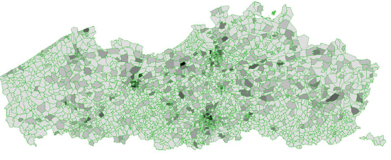
EV&BD session use case
Impact of the recharging procedure on the electric demand

Slide 17
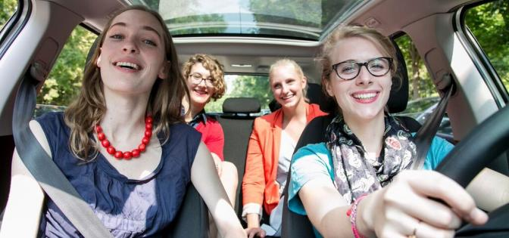
EV&BD session use case
Vehicle Occupancy Rate: 1.1-1.35 person/vehicle
http://www.madrid.es/UnidadesDescentralizadas/UDCMovilidadTransportes/MOVILIDAD/PMUS_Madrid_2/PMUS%20Madrid/Diagn%C3%B3stico%20Ejecutivo.%20PMUS%20Madrid.%2014%20feb%202014.pdf

Slide 18

EV&BD session use case
Carpooling options.
Proposal: How could you reduce the number of vehicles in Madrid, sharing trips?

Slide 19
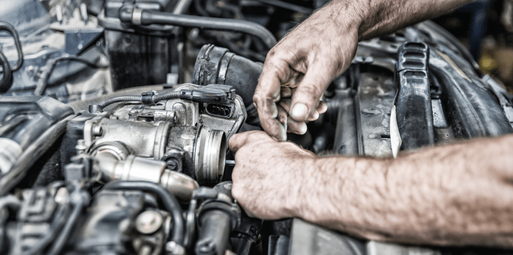
…Hands on your task!

